Slide 1
AMG+: Extended Principles Illustrated on the 1D Helmholtz Equation
Achi Brandt
Oren Livne
James Brannick
Karsten Kahl
The Multigrid Round Table
January 7, 2022

Slide 2
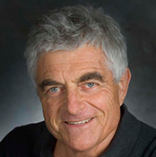
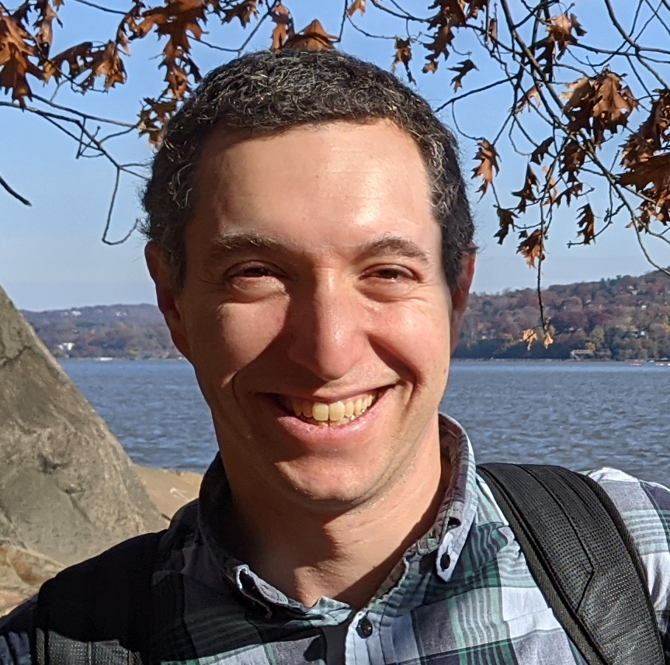
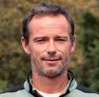
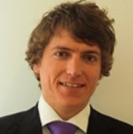
Team
Achi Brandt ACHIBR@GMAIL.COM
Weizmann Institute of Science
UCLA
Oren Livne OREN.LIVNE@GMAIL.COM
Educational Testing Service
James Brannick jjb23@psu.edu
PSU
Karsten Kahl kkahl@uni-wuppertal.de
University of Wuppertal

Slide 3
MOTIVATION
Make AMG work for many new problems
Formulate generalized guiding principles

Slide 4
The first principle is that you must not fool yourself and you are the easiest person to fool.
--Richard Feynmann
Notes:
We want to develop AMG to new specific problems, but in the process formulate generally useful principles that can apply to many new types of problems.

Slide 5
Why Multilevel Methods?
Multitude of variables/unknowns
Multilevel organization
At each level:
Relaxation
Identifying coarse-level variables
Interpolation
Coarse-level equations
For each step:
Quality Measure
Construction method
5

Slide 6
Coarse Variable construction
AMG: coarse variable = a representative/average of several “strongly connected” fine variables.
In many problems (non-elliptic, NN, …) there are no particularly strong connections.
Can coarsen only larger aggregate of moderately connected variables, with several coarse variables per aggregate.
Coarse variables are of different type than fine vars.
AMG+

Slide 7
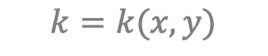
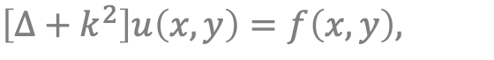
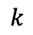
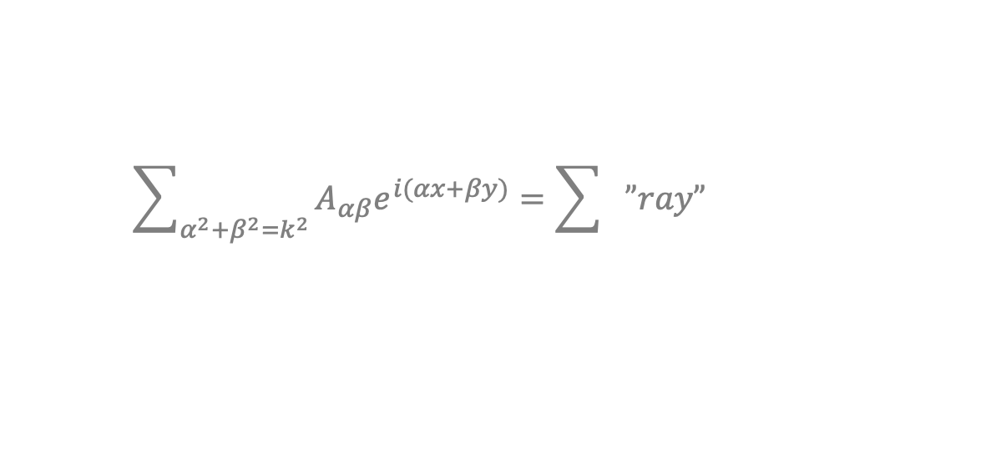
PDE Example: Helmholtz Equation
$$\left[∆+k^{2}\right]u\left(x,y\right)=f\left(x,y\right),$$
$$k=k(x,y)$$
Constant $k$: slowly converging errors are
$$\sum_{α^{2}+β^{2}=k^{2}}{A_{αβ}e^{i(αx+βy)}}=\sum{”ray”}$$
$$k$$
Moderate correlation between neighboring error values.
”Multi-coarsening” is required.
Past specialized multi-coarsening failed.
The general systematic approach works.

Slide 8
AMG+: Guiding Quality Measures
Relaxation: Residual shrinkage factor/work
Coarse variables: Mock cycle convergence factor
Interpolation: Error on test function
Coarse equation: 2-level convergence factor
Sparsity, symmetry
predicts

Slide 9
AMG+ for 1D Helmholtz
Details start here.

Slide 10
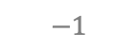
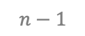
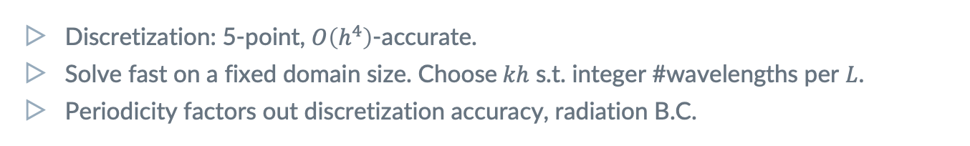
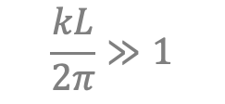
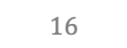
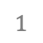
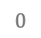
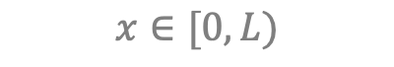
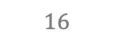
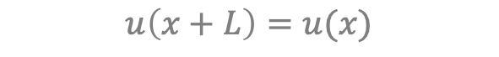
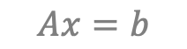
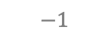
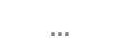
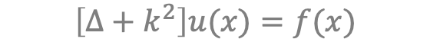
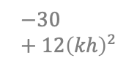
PDE Example: 1D Helmholtz
$$\frac{kL}{2π}≫1$$
$$\left[∆+k^{2}\right]u(x)=f(x)$$
$$x∈[0,L)$$
$$u\left(x+L\right)=u(x)$$
$$0$$
$$1$$
$$…$$
$$n−1$$
$$Ax=b$$
$$−1$$
$$16$$
$$−30+12{\left(kh\right)}^{2}$$
$$16$$
$$−1$$
Discretization: 5-point, $O\left(h^{4}\right)$-accurate.
Solve fast on a fixed domain size. Choose$kh$ s.t. integer #wavelengths per $L$.
Periodicity factors out discretization accuracy, radiation B.C.
Notes:
SOLVE THE 1D HELMHOLTZ EQUATION
Key challenge: automatically derive ray coarse variables from wave fine variables.
Factor out other, unrelated difficulties.
Don’t exploit particulars of Helmholtz or 1D. But --
Develop general guiding principles.

Slide 11
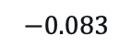
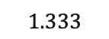
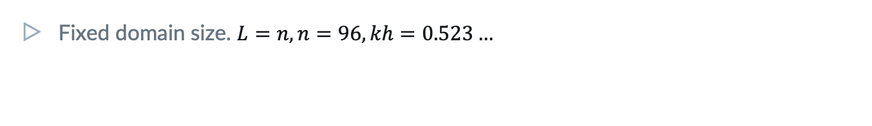
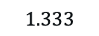
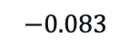
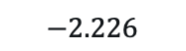
PDE Example: 1D Helmholtz
$$\frac{kL}{2π}≫1$$
$$\left[∆+k^{2}\right]u(x)=f(x)$$
$$x∈[0,L)$$
$$u\left(x+L\right)=u(x)$$
$$0$$
$$1$$
$$…$$
$$n−1$$
$$Ax=b$$
$$−0.083$$
$$1.333$$
$$−2.226$$
$$1.333$$
$$−0.083$$
Fixed domain size. $L=n, n=96, kh=0.523…$
Repetitiveness
We exploit the equations’ repetitiveness for simplicity & eyeing upscaling.

Slide 12
1. Relaxation
should exhibit a fast initial residual reduction,
starting from a random initial error.

Slide 13
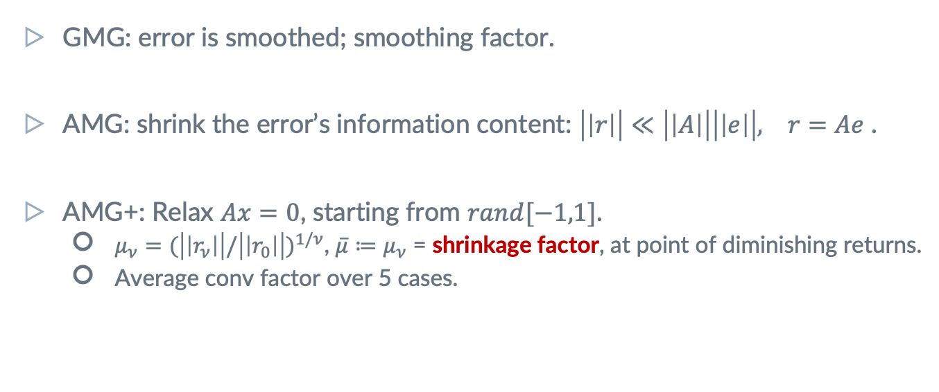
Assessing Relaxation: Shrinkage Factor
GMG: error is smoothed; smoothing factor.
AMG: shrink the error’s information content: $\left|\left|r\right|\right|≪\left|\left|A\right|\right|\left|\left|e\right|\right|, r=Ae$ .
AMG+: Relax $Ax=0$, starting from $rand[−1,1]$.
$μ_{ν}=(\left|\left|r_{ν}\right|\right|/{\left|\left|r_{0}\right|\right|)}^{1/ν}$, $\overline{μ}≔μ_{ν}$ = shrinkage factor, at point of diminishing returns.
Average conv factor over 5 cases.
Notes:
Achi will make a general comment about relaxation.
Appropriate norm is required for distributive relaxation.
For a symmetric problem, may want to prefer a symmetric relaxation scheme.

Slide 14
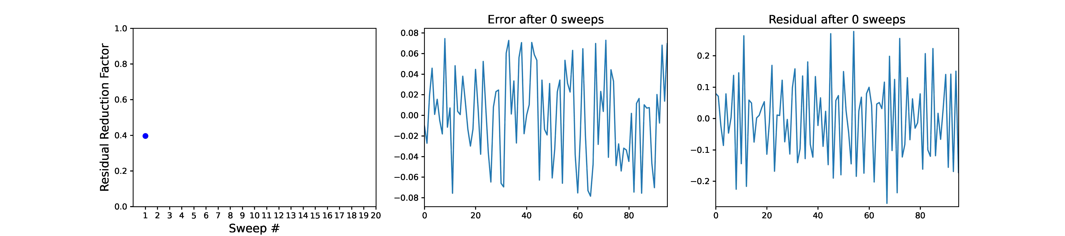
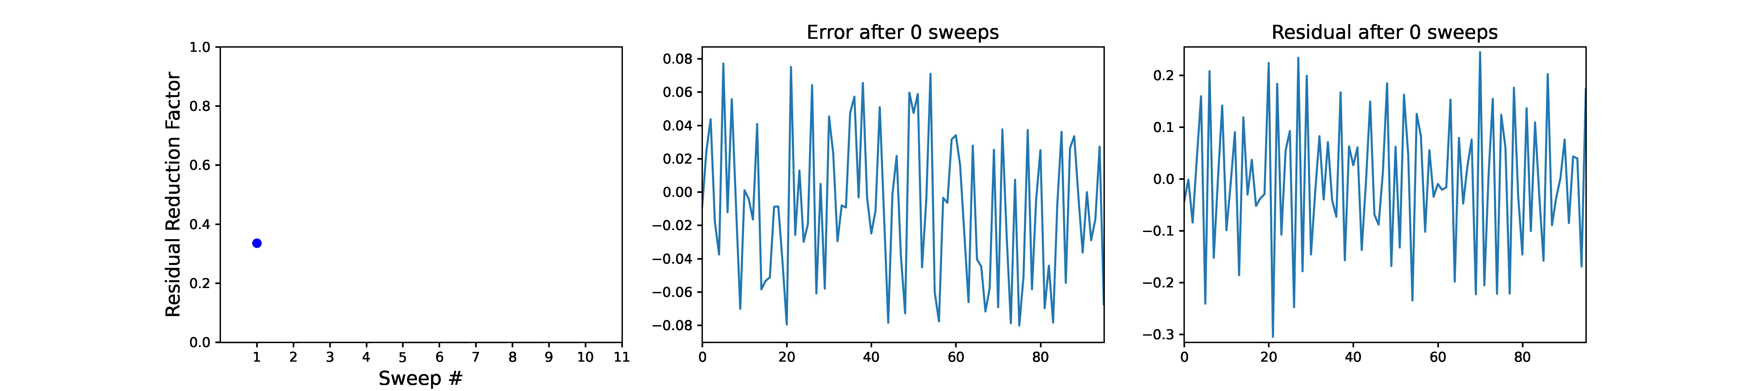
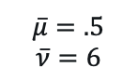
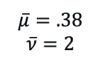
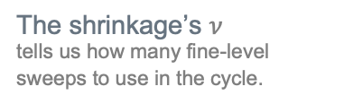
Shrinkage Factor In Action
The shrinkage’s $ν$
tells us how many fine-level sweeps to use in the cycle.
Laplace
GS
$$\overline{μ}=.5$$
$$\overline{ν}=6$$
Helmholtz
Kaczmarz
$$\overline{μ}=.38$$
$$\overline{ν}=2$$
14

Slide 15
2. Test Functions
are examples of slowly-converging errors,
which reveal connection strength between variables.

Slide 16
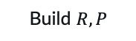
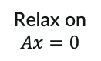
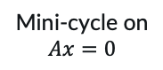
Test Functions (TFs)
Examples of slowly converging errors.
Finding Neighborhoods
Neighbors are highly correlated across TFs.
May be very different from strong coupling.
Bootstrap
Improve TFs while adding levels.
In non-linear systems,
can still produce such examples.
Separating species of vars
is important in systems.
Near null-space functions
If exist, are eventually revealed as slow-to-converge functions in the cycle.
Build $R, P$
Cycle
TFs
Relax on $Ax=0$
Random starts
Mini-cycle on $Ax=0$
Notes:
Examples can be constructed also in non-linear systems.

Slide 17
3. SVD Coarsening
reveals the right type of coarse variables, and guides the choice of coarsening ratio.

Slide 18
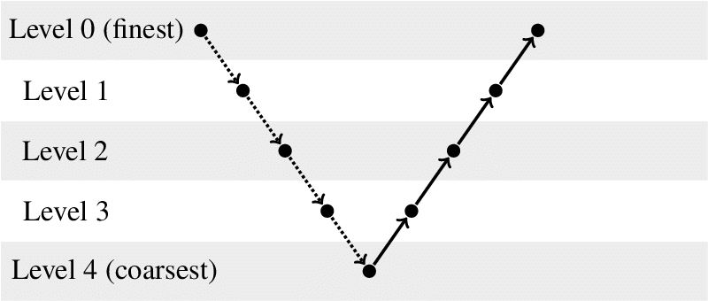
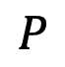
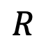
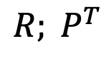
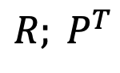
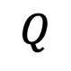
Quick Notation
Coarsening: the definition of coarse variables.
Interpolation: transfer coarse vector to fine level.
Restriction: transfer fine vector to coarse level.
For instance,
$${R; P}^{T}$$
$$R$$
$$P$$
$$Q$$
For instance,
$${R; P}^{T}$$

Slide 19
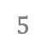
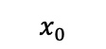
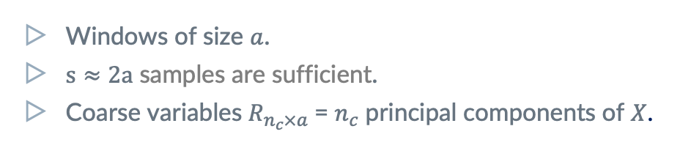

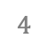
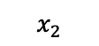
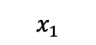








Sample Windows from single TF
$$X$$
$$=UΣV^{T}$$
$$a$$
$$x_{0}$$
$$x_{1}$$
$$s$$
$$x_{2}$$
$$…$$
$$0$$
$$1$$
$$2$$
$$3$$
$$4$$
$$5$$
$$…$$
$$n−1$$
Windows of size $a$.
$s≈2a$ samples are sufficient.
Coarse variables $R_{n_{c}×a}$= $n_{c}$ principal components of $X$.
Multiple coarse vars per aggregate.
As in SA interpolation.
Repetitive case: tile $R$
From aggregate to entire domain.
Notes:
Principal components = first n_c rows of V^T.
Non-repetitive case: Generate multiple TFs.

Slide 20


SVD Coarsening in Action: Agg Size $=4$
20
Notes:
Note: for symmetric Kaczmarz I am getting asymmetry in the values of R[0] just like for non-symmetric Kaczmarz. James mentioned they got symmetric for symmetric Kaczmarz.

Slide 21



SVD Coarsening in Action: Agg Size $=6$
$n_{c}$ = # coarse variable species.
Helmholtz: $n_{c}=2$ is natural: cos/sin, left/right waves.
21

Slide 22



How many components to use?
SVD is best rank-$n_{c}$ Frobenius approximation.
Unexplained variance = relative interpolation error
For Laplace, $R$is piecewise constant, so error can be large!
$||X−XR^{T}R|{\left.​\right|}_{2}$
$${\text{(}\sum_{i≥n_{c}}{σ_{i}^{2}}/\sum_{i}{σ_{i}^{2}})}^{1/2}$$
Use SVD only to provide tentative values of coarsening ratios.
The actual number of components to be determined by the quantitative predictor of cycle convergence.

Slide 23
4. Quantitative Quality Prediction
allows designing each multilevel component separately and reliably (coarsening & cycle).

Slide 24


Mock Cycle: Predictor of 2-level Convergence
Start with random ${x=x}_{0}$.
$\text{MockCycle}\left(R, ν\right):$
Relax $ν$ times.
Update $x$ such that $Rx=Rx_{0}.$
Direct solver/Kaczmarz
To project.
$$x←x−R^{T}{\left(RR^{T}\right)}^{−1}R(x−x_{0})$$
Use Mock Cycle asymptotic convergence factor as the ultimate coarsening quality test.
Determines the optimal aggregate size and #components.

Slide 25

Mock Cycle in Action: Convergence
 | $$ν=1$$ | $$2$$ | $$3$$ | $$4$$ | $$5$$ | $$6$$ | $$7$$ | Energy error
4/2 | .49 | .29 | .18 | .12 | .088 | .056 | .054 | .025
6/3 | .52 | .29 | .18 | .12 | .098 | .078 | .064 | .013
6/2 | .84 | .67 | .62 | .53 | .45 | .37 | .33 | .080

Slide 26



Mock Cycle in Action: Efficiency
 | $$ν=1$$ | $$2$$ | $$3$$ | $$4$$ | $$5$$ | $$6$$ | $$7$$ | Energy error
4/2 | .73 | .73 | .74 | .76 | .79 | .80 | .82 | .025
6/3 | .72 | .73 | .75 | .77 | .79 | .81 | .83 | .013
6/2 | .89 | .89 | .90 | .90 | .90 | .90 | .90 | .080
Guides the coarsening $R$.
Compare different choices. Reduction per relaxation sweep $≈$ smoothing rate, up to accuracy limit.
Generalizes LFA.
Quantitative numerical predictors > theory.
Guides the interpolation $P$.
2-level rates should attain mock cycle rates.
Prefer small aggregate size.
Aggressive coarsening can be too ambitious.

Slide 27
5. Interpolation
is constructed to accurately reproduce TFs, but tested via two-level cycle rates.

Slide 28







Ridge Least-Squares Fitting to TFs
$$0$$
$$1$$
$$2$$
$$3$$
Caliber =
2
4
$$P=R^{T}$$
$$\min_{p_{i}}{\sum_{s}{{\left(x_{is}−\sum_{j}{p_{ij}x_{js}^{c}}\right)}^{2}}}$$
${i=0..a−1; x}^{c}=Rx$.
$P_{a×?}$ tiled from aggregate to domain; stride = $2$ is possible, but $4$ is easier.
Notes:
As in BAMG.
Solve LS problem using SVD: reused for efficient $α$search.

Slide 29



Mock cycle predicts the ‘ideal’ 2-level rates
 | $$ν=1$$ | $$2$$ | $$3$$ | $$4$$ | $$5$$ | $$6$$ | $$7$$ | Fill-in | $$|A−A^{T}|$$
4/2 | .49 | .29 | .18 | .12 | .09 | .06 | .05 | - | -
$$RAR^{T}$$ | .58 | .46 | .41 | .37 | .36 | .32 | .32 | 1.2 | 0
$$RAP$$ | .51 | .28 | .17 | .12 | .09 | .07 | .06 | 1.2 | 0.0046
$$P^{T}AP$$ | .52 | .27 | .14 | .09 | .07 | .05 | .04 | 2.0 | 0
$P$: caliber 4
$ν=30$
2-level rates guide the choice of $P$.
TF reconstruction $l_{2}$ or energy error are bad predictors.

Slide 30


Coarse-level Equations
-0.08 | 1.33 | -2.23 | 1.33 | -0.08
Wave Equation
0.20 | 0.34 | -0.17 | 0.01 | 0.20 | -0.32
-0.32 | -0.56 | 0.01 | -1.46 | 0.34 | -0.56
$$RAR^{T}$$
Ray Equations
0.15 | 0.17 | -0.03 | 0.00 | 0.15 | -0.17
-0.17 | -0.16 | 0.01 | -0.63 | 0.17 | -0.16
$$RAP$$

Slide 31




Coarse-level Equations: Symmetrize
-0.08 | 1.33 | -2.23 | 1.33 | -0.08
$$Ae=r$$
$$QAPe^{c}=Qr$$
$$APe^{c}=r$$
0.15 | 0.17 | -0.03 | 0.01 | 0.15 | -0.17
-0.17 | -0.16 | 0.01 | -0.63 | 0.17 | -0.16
$$QAP$$

Slide 32
6. Bootstrap
Improves and reveals test functions as more levels are gradually added to the multilevel solver.

Slide 33


3-level Cycle Works
 | $$ν=3$$ | $$4$$ | $$5$$ | $$6$$ | $$7$$ | Fill-in | $$|A−A^{T}|$$
Mock | .18 | .12 | .09 | .06 | .05 | - | -
0 -> 1 | .36 | .24 | .23 | .23 | .11 | 1.2 | 0
1 -> 2 Shrinkage | .34 | .24 | .16 | .13 | .11 | 1 | 0
3-level, V | .81 | .31 | .20 | .16 | .11 | - | -
$RAP, P$: caliber 4

Slide 34



Save Setup Cost by Switching $Q$’s
Smooth TFs more efficiently by mini-cycles with $P=R^{T}$ to obtain high-order $P$.
$R$ requires only little smoothing.
Setup work dominated by SVD, though.
Temporarily work with expensive, accurate operator for 2-level bootstrapping ($A^{c}=P^{T}AP$).
Post-processing:
Sparsify: $A^{c}=RAP$.
Symmetrize $A^{c}=QAP$.
AMG+ uses $R$!
For the first time, $R$is not just a prediction tool (mock cycle), but used in bootstrap & solver.
Notes:
We are free to switch between different Q’s during setup.

Slide 35



Mini-Cycle Shrinkage in Action
Kaczmarz
2-level Cycle(2,2;4)
Mini-cycle shrinks
more efficiently than relaxation, even if asymptotically slow.
$\overline{μ}=.58$
$\overline{ν}=6$
$\overline{μ}=.04$
${\overline{μ}}^{1/W}=.38$
$\overline{ν}=1$
35

Slide 36
7. Coarse-level Construction is Local,
which is especially useful for repetitive problems & upscaling.

Slide 37

Coarse-level Construction is Local (**In Principle)
Relaxation is local, so producing TFs is local.
In repetitive problems, sample across the domain.
Mock cycle rate well estimated on domain size = $4 × \text{aggregate}\text{_}\text{size}$.
Two-level cycle rate well estimated on domain size = $4 × \text{aggregate}\text{_}\text{size}$.
Only shrinkage is important, not asymptotic rate.
Notes:
Examples can be constructed also in non-linear systems.
In graph problems,
define domain as a graph neighborhood of a node.

Slide 38


Systematic Upscaling (WIP)
Deriving equations at increasingly coarser scale.
Creating interpretable coarse-level variables.
Step 1:
Take a large enough, fixed size domain.
Derive all levels’ $R, P$, operators.
Tile & use them on a larger domain.
Step 2:
Double domain size on every coarsening stage.

Slide 39

Recap of AMG+ Principles
Relaxation should have good shrinkage.
Test Functions (TFs) are used to construct coarsening & interpolation and.
Coarse-level variables are obtained by local TF SVD and tested by the mock cycle.
Quantitative quality prediction tools, e.g., the mock cycle, guide the separate design of each multigrid component.
Interpolation is constructed by least-squares fitting of TF values, but ultimately tested via 2-level cycle shrinkage factor.
TFs & cycle are iteratively improve each other via bootstrap.
Coarse-level construction is a local process and naturally supports upscaling.

Slide 40
Thanks!
Questions/Ideas for Applications?
Twitter
#AMG+
Email us at
achibr@gmail.com
oren.livne@gmail.com
jjb23@psu.edu
kkahl@uni-wuppertal.de

Slide 41
EXTRA SLIDES

Slide 42
Principle (n.). a general scientific theorem or law that has numerous special applications across a wide field.
Notes:
We want to develop AMG to new specific problems, but in the process formulate generally useful principles that can apply to many new types of problems.

Slide 43





















Challenging Problems for AMG
Nearly Singular
Systems
Species are not explicitly identified
Highly indefinite
Emerging types of coarse variables
$$\left|ε\left(x\right)\right|≪\frac{1}{\text{L}}$$
$\left[∆ − ε{\left(x\right)}^{2}\right]u\left(x\right)=f\left(x\right)$,
$$V$$
$$V$$
Stokes
$$U$$
$$P$$
$$U$$
$$P$$
$$U$$
$$V$$
$$V$$
$$U$$
$$P$$
$$U$$
$$P$$
$$U$$
$$V$$
$$V$$
$$\left[∆+k^{2}\right]u=f$$
$$k≫\frac{1}{\text{L}}$$
Multiple types: directional rays
$$k$$
43

Slide 44

Challenging Problems for AMG (Cont.)
Upscaling
Deriving equations at increasingly coarser scale
Creating interpretable coarse-level variables
Non-linear systems
where a coarse version is not given
Inverse Problems
Non-local equations
Stochastic Optimization
No geometric locations
No locality graph
$$\int{g\left(x,y\right)u\left(y\right)dy=}f(x,u)$$
Neural networks
44
Notes:
This work was inspired by work on challenges in neural networks, which include the last 3 items in this list. (and more)

Slide 45
Goals
SOLVE THE 1D HELMHOLTZ EQUATION
Key challenge: automatically derive ray coarse variables from wave fine variables.
Don’t exploit particulars of Helmholtz or 1D.
Factor out other, unrelated difficulties.
DEVELOP GENERAL MULTILEVEL PRINCIPLES
that can apply to a wide variety of problems.

Slide 46



Ridge Least-Squares Fitting to TFs
$$0$$
$$1$$
$$2$$
$$3$$
Caliber =
2
4
$$P=R^{T}$$
$$\min_{p_{i}}{\sum_{s}{W_{is}{\left(x_{is}−\sum_{j}{p_{ij}x_{js}^{c}}\right)}^{2}}+α\sum_{s}{W_{is} {\left(x_{is}\right)}^{2}}}$$
${i=0..a−1; x}^{c}=Rx$.
Weighting $W_{is}={\left|\left|r_{is}\right|\right|}^{−2} ,$local norm; unimportant for comparable TFs.
$α$ determined by minimizing interpolation error on validation samples. (Use SVD!)
$P_{a×?}$ tiled from aggregate to domain; stride = $2$ is possible, but $4$ is easier.
Notes:
As in BAMG.
Solve LS problem using SVD: reused for efficient $α$search.

